Slide 1

Practical Aspects of Deep Learning
Learning Objective:
Give examples of how different types of initializations can lead to different results
Examine the importance of initialization in complex neural networks
Explain the difference between train/dev/test sets
Diagnose the bias and variance issues in your model
Assess the right time and place for using regularization methods such as dropout or L2 regularization
Explain Vanishing and Exploding gradients and how to deal with them
Use gradient checking to verify the accuracy of your backpropagation implementation

Slide 2
Practical Aspects of Deep Learning
1 Train/dev/test sets
2 Bias/Variance
3 Basic “recipe” for machine learning
4 Regularization
5 Why regularization reduces overfitting
6 Dropout regularization
7 Understanding dropout
8 Other regularization methods
9 Normalizing inputs
10 Vanishing/exploding gradients
11 Numerical approximation of gradients
12 Gradient Checking
13 Gradient Checking implementation notes

Slide 3
Setting up your ML application
Train/dev/test sets

Slide 4
Applied ML is a highly iterative process
When training a neural network, you have to make a lot of decisions such as how many layers and hidden units your network should have, the learning rate, and activation functions.
However, it is almost impossible to correctly guess the right values for all of these on your first attempt.
Therefore, applied deep learning is an iterative process where you start with an idea and code it up to try it out, and based on the outcome, you refine your ideas and change your choices until you find a better neural network.
Notes:
Deep learning is an iterative process and that making good choices in setting up your training, development, and test sets can make a huge difference in helping you quickly find a good high-performance neural network.
When training a neural network, you have to make a lot of decisions such as how many layers and hidden units your network should have, the learning rate, and activation functions. However, it is almost impossible to correctly guess the right values for all of these on your first attempt. Therefore, applied deep learning is an iterative process where you start with an idea and code it up to try it out, and based on the outcome, you refine your ideas and change your choices until you find a better neural network.

Slide 5

Applied ML is a highly iterative process
# layers
# hidden units learning rates activation functions
…
Idea
Experiment
Code

Slide 6
Applied ML is a highly iterative process
The importance of setting up your data sets well, in terms of your train, development, and test sets, and gives some traditional ratios for splitting the data. However, in the modern big data era, it's also fine to set your dev and test sets to be much smaller than your 20% or even 10% of your data. It might be okay to not have a test set if you don't need an unbiased estimate of the performance of your algorithm.
Setting up a train dev and test set will allow you to integrate more quickly and efficiently measure the bias and variance of your algorithm so you can more efficiently select ways to improve it.
Notes:
Deep learning has found great success in many areas, such as natural language processing, computer vision, speech recognition, and structured data, and the best choices may depend on various factors such as the amount of data you have, the number of input features, and your computer configuration.
The importance of setting up your data sets well, in terms of your train, development, and test sets, and gives some traditional ratios for splitting the data. However, in the modern big data era, it's also fine to set your dev and test sets to be much smaller than your 20% or even 10% of your data. It might be okay to not have a test set if you don't need an unbiased estimate of the performance of your algorithm.
Setting up a train dev and test set will allow you to integrate more quickly and efficiently measure the bias and variance of your algorithm so you can more efficiently select ways to improve it.

Slide 7
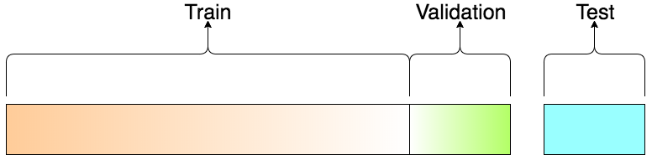
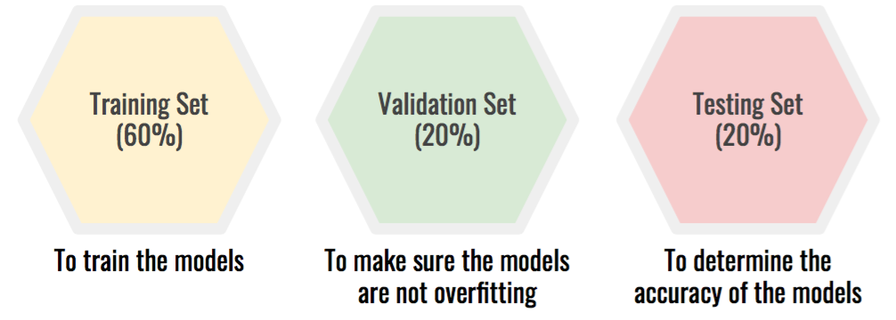
Train/dev/test sets

Slide 8
Mismatched train/test distribution
Training set:
Cat pictures from webpages
Dev/test sets:
Cat pictures from users using your app
Not having a test set might be okay. (Only dev set.)

Slide 9
Setting up your ML application
Bias/Variance

Slide 10
Bias/Variance
Bias refers to the difference between the expected predictions of a model and the true values of the data.
Variance refers to the amount by which a model's predictions can vary as new data points are fed into the model.
A good machine learning practitioner needs to have a sophisticated understanding of this concept because it is easily learned but difficult to master.
Notes:
The concept of Bias and Variance is an important one in machine learning.
Bias refers to the difference between the expected predictions of a model and the true values of the data.
Variance refers to the amount by which the model's predictions vary for different training sets.
A good machine learning practitioner needs to have a sophisticated understanding of this concept because it is easily learned but difficult to master.

Slide 11
Bias/Variance
In deep learning, there is less discussion of the bias/variance trade-off because there is less of a trade-off in deep learning errors.
The bias/variance trade-off refers to the balance between underfitting and overfitting.
Underfitting occurs when the model is too simple and cannot capture the complexity of the data.
Overfitting occurs when the model is too complex and fits the training data too closely, resulting in poor performance on the test data. The sweet spot is somewhere in between, where the model is just right.

Slide 12
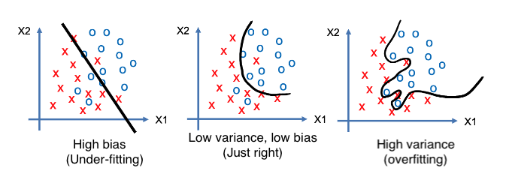
High bias and high variance

Slide 13
Bias/Variance
To diagnose whether a model has a bias or variance problem, the two key numbers to look at are the train set error and the dev set error:
If the training set error is low, but the dev set error is high, then the model may have high variance.
If the training set error is high and the dev set error is also high, then the model may have high bias.
If the training set error is high, but the dev set error is even higher, then the model may have both high bias and high variance.

Slide 14
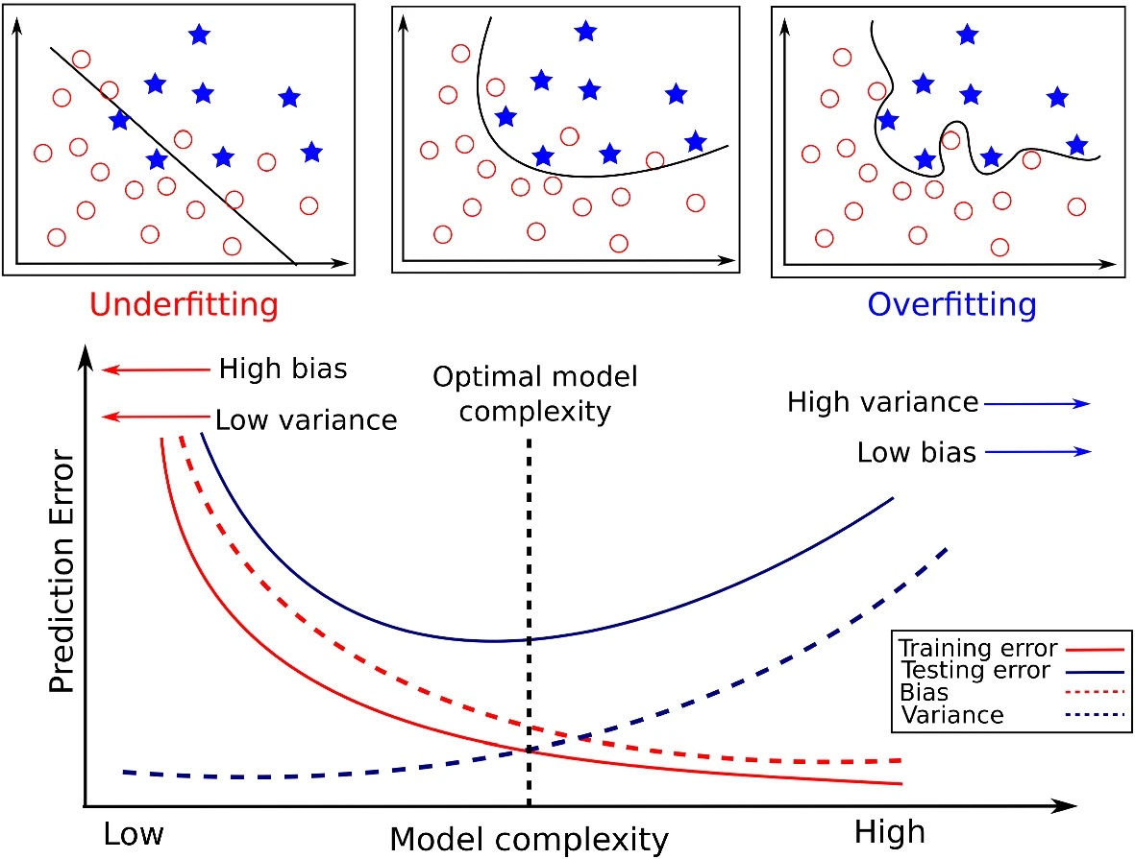
Bias and Variance

Slide 15
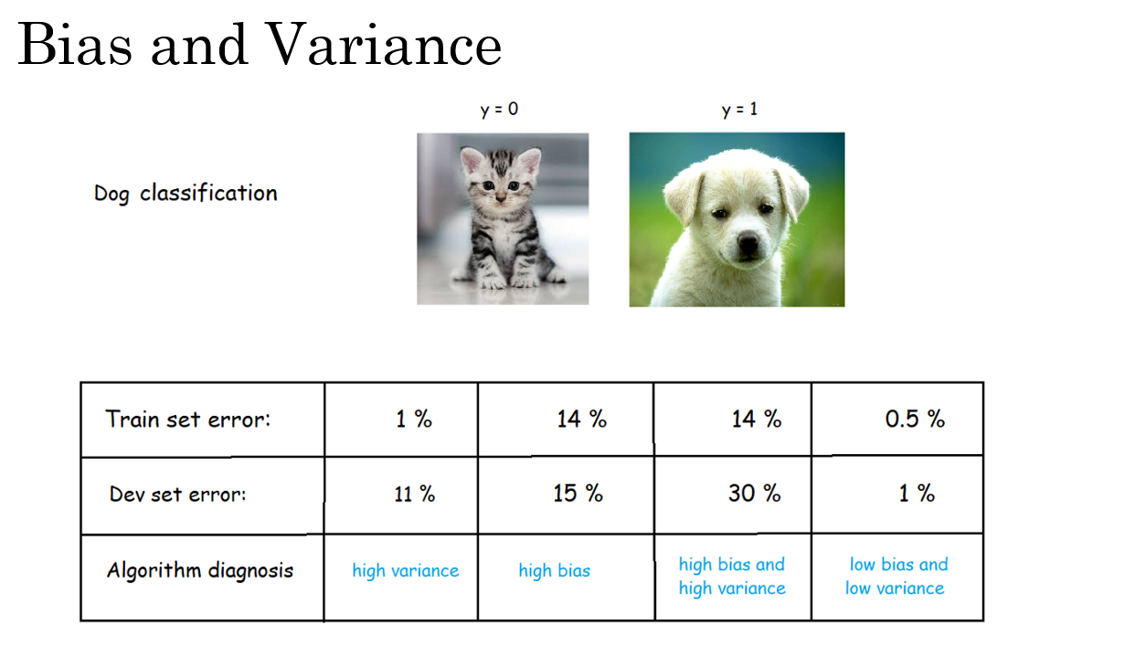

Slide 16
Bias/Variance
The assumption in this analysis is that the Bayes error is quite small, and that the training and dev sets are drawn from the same distribution. If these assumptions are violated, a more sophisticated analysis may be needed.
By understanding whether a model has high bias or high variance, a machine learning practitioner can try different techniques to improve the model's performance.

Slide 17
Setting up your ML application
Basic “recipe”
for machine
learning

Slide 18
Basic recipe for machine learning
A basic recipe for machine learning can improve the performance of an algorithm.
The first step is to diagnose whether the algorithm has a high bias problem.
- If this is the case, trying to pick a larger network with more hidden layers or hidden units, train for a longer time, or try a more advanced optimization algorithm.
- If none of these options work, trying a different neural network architecture.
- The goal is to reduce bias to an acceptable amount.
The second step is to diagnose whether the algorithm has a high variance problem.
- To reduce variance, getting more data, using regularization, or trying a more appropriate neural network architecture.
- The goal is to reduce variance to an acceptable amount.
Notes:
A basic recipe for machine learning can improve the performance of an algorithm.
The first step is to diagnose whether the algorithm has a high bias problem, which means it is not even fitting the training set well.
- If this is the case, trying to pick a larger network with more hidden layers or hidden units, train for a longer time, or try a more advanced optimization algorithm.
- If none of these options work, the speaker suggests trying a different neural network architecture.
- The goal is to reduce bias to an acceptable amount.
Once bias is reduced, the second step is to diagnose whether the algorithm has a high variance problem, which means it is not generalizing well from the training set to the dev set. To reduce variance, the speaker suggests getting more data, using regularization, or trying a more appropriate neural network architecture. Again, the goal is to reduce variance to an acceptable amount.

Slide 19
Basic recipe for machine learning
The set of things to try depends on whether the algorithm has a high bias or high variance problem.
Note: in the modern deep learning era, getting a bigger network almost always reduces bias without necessarily hurting variance, so long as the network is regularized appropriately. The same is true for getting more data, which almost always reduces variance without hurting bias much.
Finally, regularization is a useful technique for reducing variance but can increase bias slightly.

Slide 20
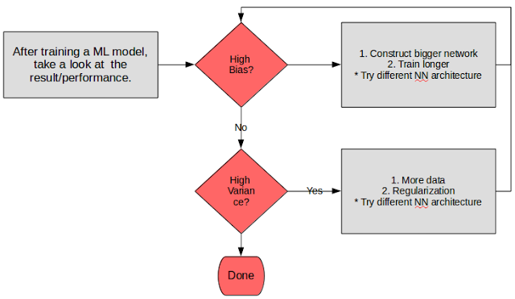
Basic recipe for machine learning

Slide 21
Regularizing your neural network
Regularization

Slide 22
Regularization
Regularization helps prevent overfitting in a neural network by adding a penalty term to the cost function that encourages the weights to be small. This smallness of weights can help prevent the network from becoming too complex and overfitting the training data.
There are several types of regularization techniques which the model tries to minimize during training. The penalty term discourages the model from learning too much from the training data and encourages it to find simpler solutions that generalize better to new data.
Notes:
Regularization helps prevent overfitting in a neural network by adding a penalty term to the cost function that encourages the weights to be small. This smallness of weights can help prevent the network from becoming too complex and overfitting the training data.
In other words, when a neural network has a large number of parameters, it can fit the training data very well, but it may not generalize well to new, unseen data. By adding a regularization term to the cost function, the neural network is encouraged to find weight values that are not only good at fitting the training data but also simple and smooth.
There are several types of regularization techniques, but they all work by adding a penalty term to the loss function, which the model tries to minimize during training. The penalty term discourages the model from learning too much from the training data and encourages it to find simpler solutions that generalize better to new data.

Slide 23
Regularization
One common type of regularization is L2 regularization, also known as Ridge regression, which adds a penalty term to the loss function proportional to the square of the magnitude of the model weights. This encourages the model to learn small weights and reduces the impact of any individual feature on the prediction.
Another type of regularization is L1 regularization, also known as Lasso regression, which adds a penalty term proportional to the absolute value of the model weights. This has the effect of shrinking some weights to zero, effectively performing feature selection and making the model more interpretable.

Slide 24
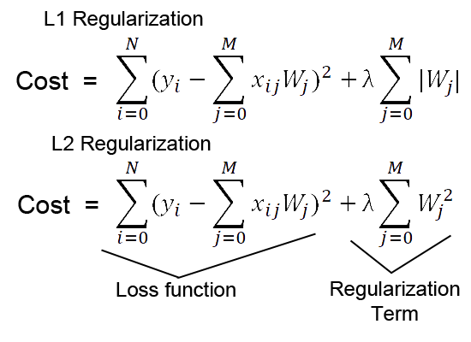
Regularization

Slide 25
Regularization
Finally, there is dropout regularization, which randomly drops out some units in the neural network during training, preventing any single unit from becoming too important and reducing the risk of overfitting.
Overall, regularization is an important technique for improving the generalization performance of machine learning models, and it should be considered as a standard part of the modeling process.

Slide 26
Regularizing your neural network
Why regularization reduces overfitting

Slide 27
How does regularization prevent overfitting?
L2 regularization encourages the model to distribute the weights more evenly across all features rather than relying heavily on a few features. When the regularization parameter λ is set appropriately, it penalizes large weight values, discouraging the model from assigning excessively high weights to any single feature.
In summary, L2 regularization prevents overfitting by adding a penalty term to the cost function that encourages the model to have smaller and more evenly distributed weights across features. This leads to a more robust and generalizable model, reducing the likelihood of overfitting to the training data.
Notes:
L2 regularization encourages the model to distribute the weights more evenly across all features rather than relying heavily on a few features. When the regularization parameter λ is set appropriately, it penalizes large weight values, discouraging the model from assigning excessively high weights to any single feature.
By spreading the importance of the features more evenly and discouraging large weight values, L2 regularization helps to prevent overfitting. Overfitting occurs when a model learns to fit the training data too well, including noise and irrelevant patterns, which leads to poor generalization to unseen data. L2 regularization encourages the model to be more robust and generalize better by regularizing the weights.
In summary, L2 regularization prevents overfitting by adding a penalty term to the cost function that encourages the model to have smaller and more evenly distributed weights across features. This leads to a more robust and generalizable model, reducing the likelihood of overfitting to the training data.

Slide 28
How does regularization prevent overfitting?
L1 regularization has the property of introducing sparsity in the model because it encourages many of the model's weights to be exactly zero. When the regularization parameter λ is set appropriately, it effectively forces less important features to have zero weights, effectively excluding them from the model's calculations. In this way, L1 regularization can help the model focus on the most relevant features and reduce the complexity of the learned model.
In summary, L1 regularization prevents overfitting by adding a penalty term to the cost function that encourages sparsity in the model's weights, leading to a simpler and more generalizable model.
Notes:
L1 regularization has the property of introducing sparsity in the model because it encourages many of the model's weights to be exactly zero. When the regularization parameter λ is set appropriately, it effectively forces less important features to have zero weights, effectively excluding them from the model's calculations. In this way, L1 regularization can help the model focus on the most relevant features and reduce the complexity of the learned model.
By introducing sparsity and reducing the number of features used in the model, L1 regularization helps to prevent overfitting. Overfitting occurs when a model learns to fit the training data too well, including noise and irrelevant patterns, which leads to poor generalization to unseen data. L1 regularization promotes a more straightforward and interpretable model with fewer features, making it less prone to fitting noise and overfitting.
In summary, L1 regularization prevents overfitting by adding a penalty term to the cost function that encourages sparsity in the model's weights, leading to a simpler and more generalizable model.

Slide 29
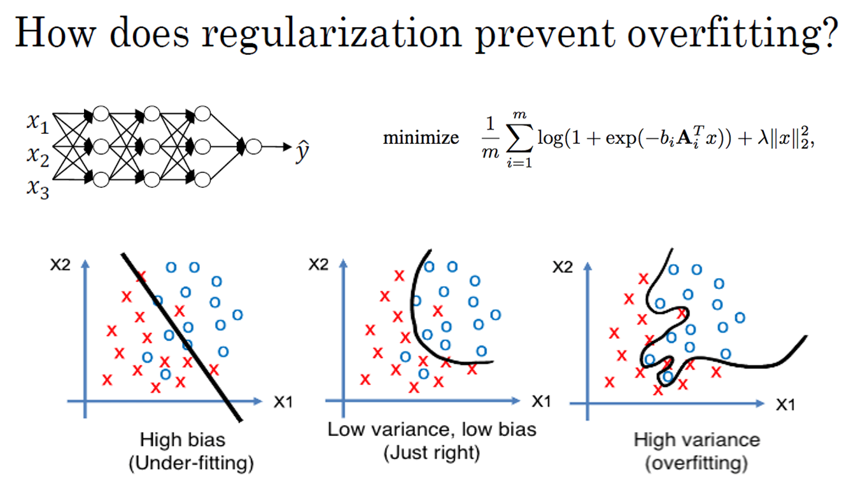

Slide 30
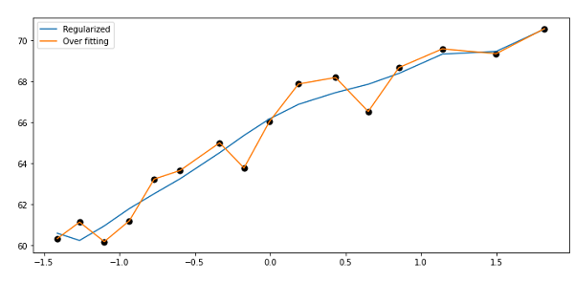
How does regularization prevent overfitting?

Slide 31
Regularizing your neural network
Dropout regularization

Slide 32
Dropout regularization
Dropout is a powerful regularization technique that can help prevent overfitting in neural networks. The basic idea of dropout is to randomly eliminate, or "drop out," some nodes in the neural network during training. This means that the network is effectively training on a smaller, more reduced version of itself.
To implement dropout, we first set a probability for each node in each layer of the network. For example, we might set a probability of 0.5 for each node in each layer. Then, for each training example, we toss a coin for each node to determine whether or not to keep it. If the coin lands on heads, we keep the node. If the coin lands on tails, we eliminate the node and all its outgoing connections. We then train the neural network using this reduced version of itself.

Slide 33
Dropout regularization
We implement dropout using a technique called "inverted dropout," which involves scaling up the activations of the remaining nodes by a factor of 1/keep.prob, where keep.prob is the probability of keeping each node. This ensures that the expected value of the activations remains the same.
At test time, we don't use dropout explicitly, since we don't want our predictions to be random. Instead, we use the full, un-dropped-out neural network to make predictions.
The reason dropout works is because it helps prevent overfitting by reducing the co-adaptation between neurons. When we drop out some nodes during training, the remaining nodes must learn to perform the task on their own, rather than relying on co-adaptation with other nodes. This can lead to more robust generalization performance on new data.

Slide 34
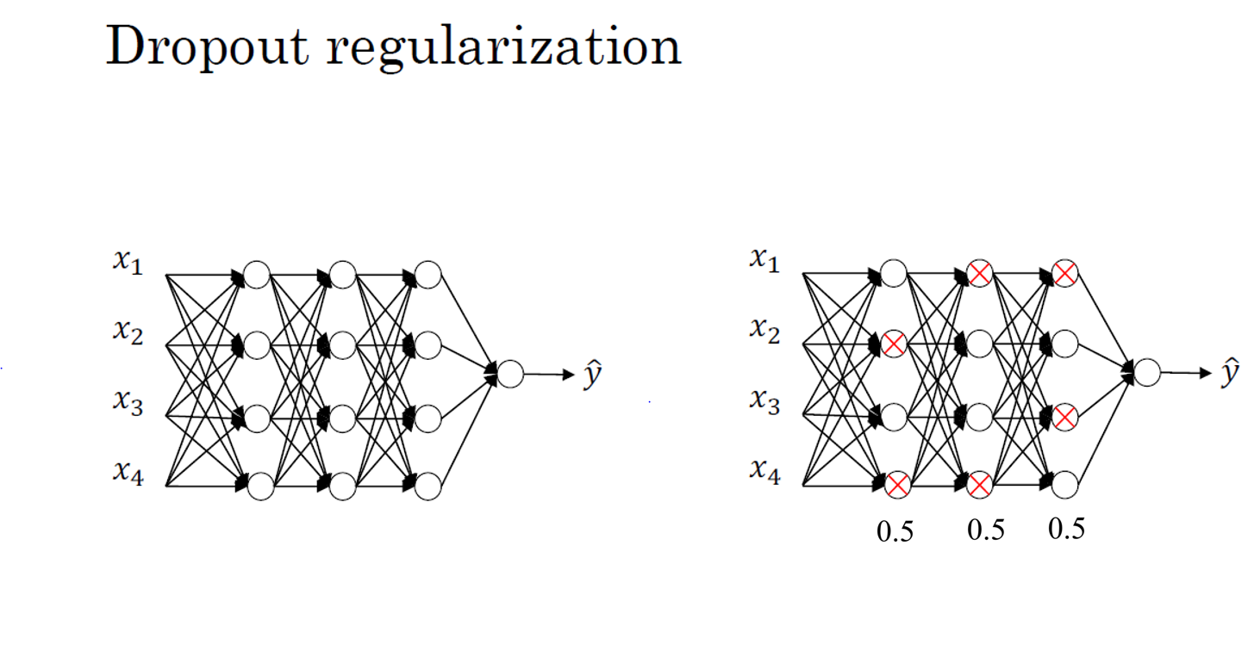

Slide 35
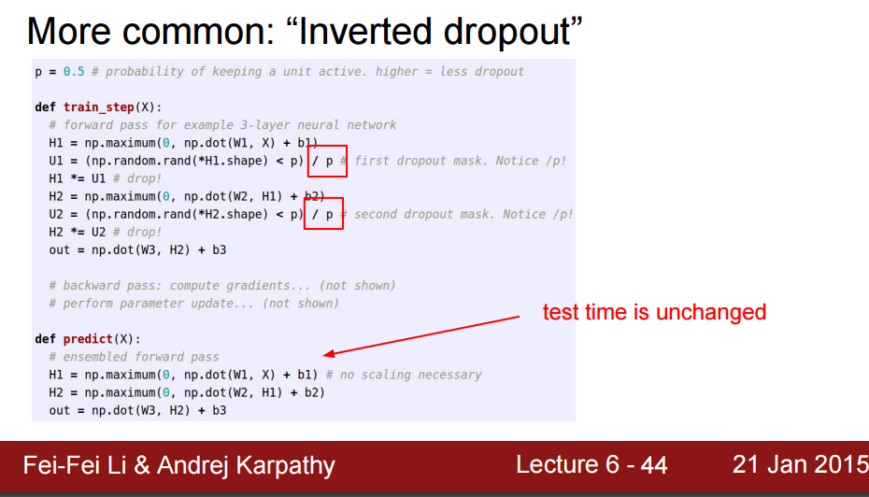
Implementing dropout (“Inverted dropout”)

Slide 36
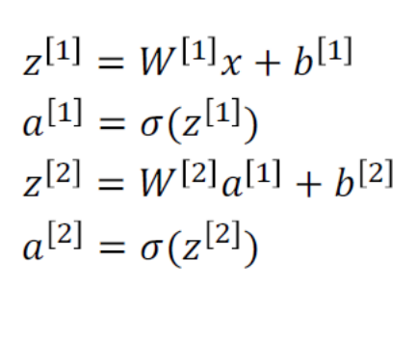
Making predictions at test time
No drop-out

Slide 37
Regularizing your neural network
Understanding dropout

Slide 38
Why does drop-out work?
Dropout encourages weight diversification in the network, preventing overreliance on specific inputs. Random elimination of inputs prompts units to evenly distribute weights, reducing the squared norm, similar to L2 regularization.
In practice, we select a "keep prop" parameter representing the likelihood of retaining units in each layer. This parameter can be adjusted per layer, with lower values for layers of concern regarding overfitting.
Notes:
Dropout forces the network to spread out its weights and not rely too heavily on any one input or feature. When a unit's inputs can get randomly eliminated, it can't rely on any one feature because it could go away at random. As a result, the unit will be more motivated to spread out its weights and give a little bit of weight to each of its inputs. By spreading out the weights, this tends to have an effect of shrinking the squared norm of the weights, similar to what we saw with L2 regularization.
In practice, we choose a "keep prop" parameter, which is the chance of keeping a unit in each layer. We can vary the keep prop by layer, with lower values for layers where we are more worried about overfitting.

Slide 39

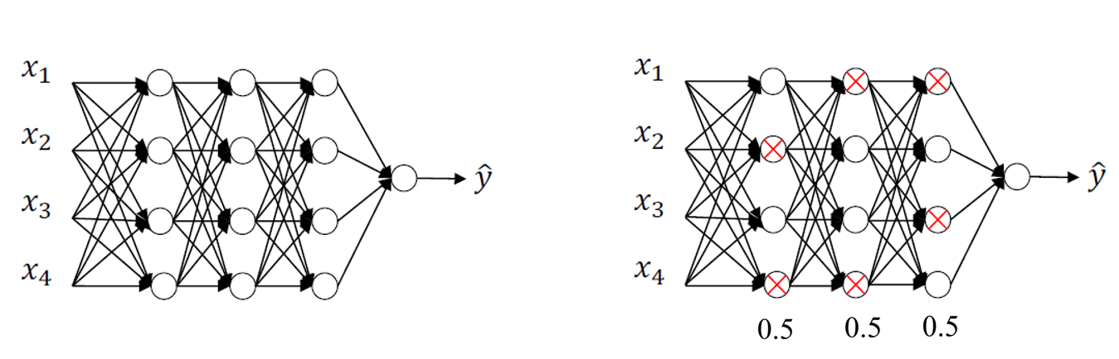
Why does drop-out work?
Intuition: Can’t rely on any one feature, so have to spread out weights.

Slide 40
Why does drop-out work?
One downside of dropout is that it makes the cost function J less well defined on every iteration, as we are randomly knocking out units. This makes it harder to double check the performance of the network, and we may need to turn off dropout to check that our code is working properly.
While dropout is frequently used in computer vision, it may be less useful in other application areas where overfitting is less of an issue. There are also other regularization techniques, which we will discuss in the next slides.

Slide 41
Regularizing your neural network
Other regularization methods

Slide 42











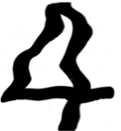


Other regularization methods
data augmentation involves creating additional training examples by distorting existing ones, such as flipping images horizontally or taking random crops of an image. By doing this, the algorithm is trained on a more diverse set of examples, which can help it generalize better.
4

Slide 43
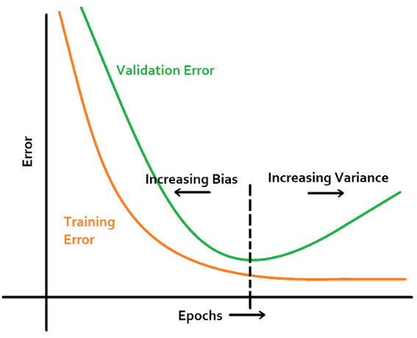
Other regularization methods
Early stopping involves stopping the training process before it reaches the point of overfitting. This is done by monitoring the performance of the model on a validation set during training and stopping when the validation error starts to increase. By doing this, the model is prevented from continuing to fit the noise in the training data and is forced to generalize better.

Slide 44
Other regularization methods
However, Early stopping can couple the optimization and regularization tasks, making it more complicated to search for hyperparameters. Using L2 regularization instead and trying different values of the regularization parameter lambda, which can make the search space of hyperparameters easier to decompose and search over.
The concept of orthogonalization involves separating the tasks of optimizing the cost function and reducing overfitting. By doing this, it becomes easier to search for hyperparameters and optimize the model efficiently.

Slide 45
Setting up your optimization problem
Normalizing inputs

Slide 46
Normalizing training sets
Normalizing input features means scaling the features so that they are on similar scales. This is done to make the cost function of the neural network more symmetric, which makes it easier and faster to optimize. The normalization process involves two steps:
- The first step is to subtract the mean from each feature, so that the features have zero mean.
- The second step is to divide each feature by its standard deviation (variance), so that the features have unit variance.
Normalizing input features is important when the input features come from very different scales, as this can make it difficult for the optimization algorithm to converge. If the features are on similar scales, normalization is less important, but it is still a good practice to perform.

Slide 47
Normalizing training sets
Note that in the following diagram feature x₁ has very much larger variance than feature x₂ here. After variance normalization, the variance of x₁ and x₂ are both equal to 1.

Slide 48
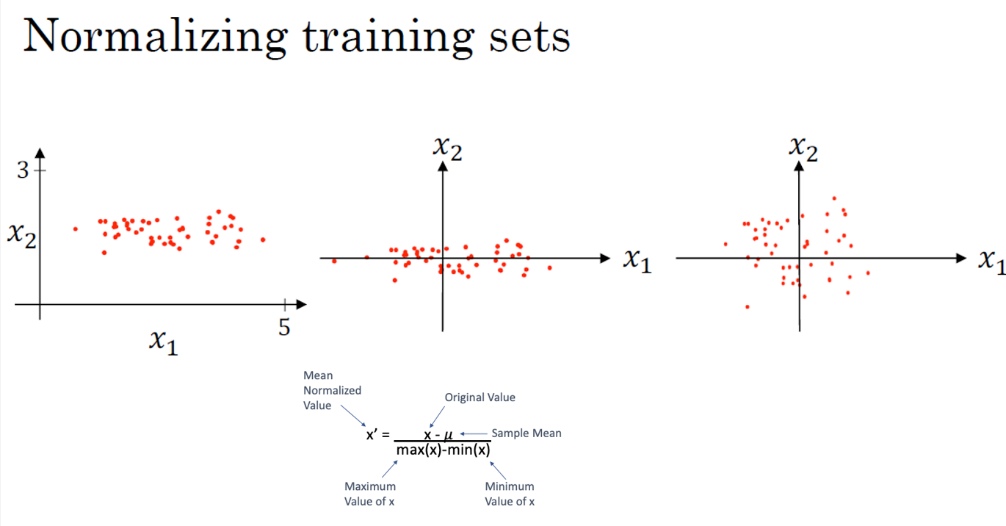
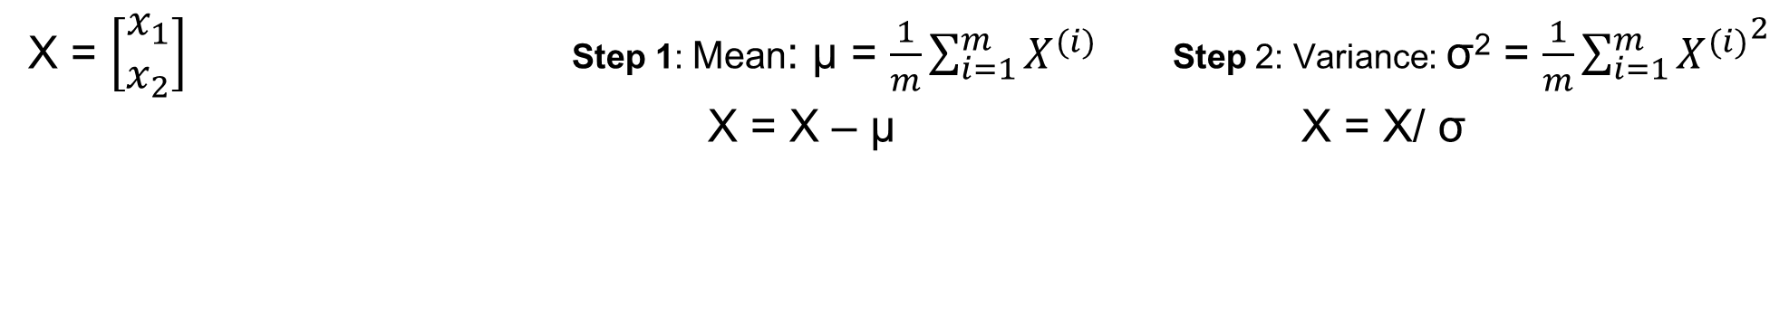
X = $\left[\begin{aligned}x_{1} \\ x_{2}\end{aligned}\right]$ Step 1: Mean: μ = $\frac{1}{m}\sum_{i=1}^{m}{X^{(i)}}$ Step 2: Variance: σ² = $\frac{1}{m}\sum_{i=1}^{m}{{X^{(i)}}^{2}}$
X = X – μ X = X/ σ

Slide 49
Normalizing training sets
It is also important to use the same normalization parameters (mean and standard deviation) for both the training and test sets, so that the test set is scaled in the same way as the training set. This ensures that the test set is evaluated on the same features that the neural network was trained on.

Slide 50
Why normalize input?
When you training a deep network, the gradient may be very big or very small and this makes training difficult, namely the problem of vanishing or exploding gradient. You can carefully choose the random weight initialization hopefully that your weight will not explode so quickly or decay to zero quickly, so, you can train a reasonable deep network without your weight exploding or vanishing so much.
For an example: deep network with each neuron having the linear function as the activation function, and set b^{[i]} being zero:
- If we initialize W^{[i]} a little bigger than the identity matrix, then with very deep networks the activation can explode.
- If W^{[i]} is just a little bit less than the identity, then the activation will decrease exponentially.

Slide 51
Why normalize input?
There are several reasons why normalizing input data is important:
Improves Convergence: Many machine learning algorithms, such as gradient-based optimization methods (e.g., gradient descent), converge faster when the input features are on a similar scale. Normalizing the features ensures that all features contribute equally to the learning process, which can speed up the training process and lead to quicker convergence.
Prevents Dominance of Features: If features have different scales, those with larger scales can dominate the learning process. Algorithms might give more weight to features with larger values, even if they are not necessarily more important. Normalizing the features prevents this issue and ensures that no single feature dominates the learning algorithm.
Enhances Model Performance: Normalizing input data can improve the performance and accuracy of the machine learning model. Algorithms like support vector machines, k-nearest neighbors, and neural networks are particularly sensitive to feature scales. Normalizing the features helps these algorithms perform better and make more accurate predictions.
Interpretability: Normalized features make it easier to interpret the model coefficients or feature importance values. When features are on the same scale, it's simpler to compare their importance and understand their contributions to the model's predictions.
Regularization: Regularization techniques (such as L1 and L2 regularization) penalize large coefficients. Normalizing the input features ensures that the regularization term applies uniformly to all features, preventing some features from being unfairly penalized due to their scale.

Slide 52
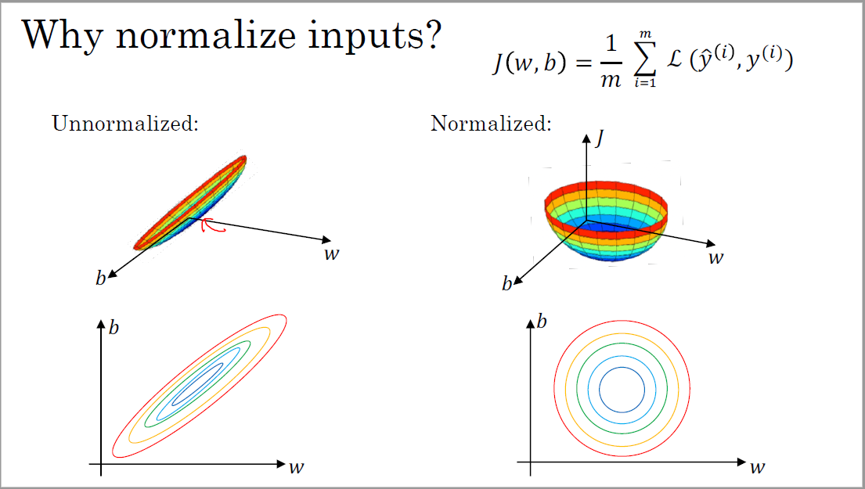
J

Slide 53
Setting up your optimization problem
Vanishing/exploding gradients

Slide 54
Vanishing/exploding gradients
In neural network training, the problem of vanishing and exploding gradients can occur, especially in very deep neural networks. This problem arises when the derivatives or slopes become very large or very small:
- If each weight matrix in a deep network is slightly larger than the identity matrix, then the output can explode exponentially.
- While if each matrix is slightly smaller than the identity matrix, then the activations can decrease exponentially.
- Similarly, the derivatives or gradients can increase or decrease exponentially with the number of layers in a deep network.
This problem makes training difficult, especially if the gradients become exponentially small, as gradient descent will take tiny steps and take a long time to learn anything.
Notes:
In neural network training, the problem of vanishing and exploding gradients can occur, especially in very deep neural networks. This problem arises when the derivatives or slopes become very large or very small, which makes training difficult.
- If each weight matrix in a deep network is slightly larger than the identity matrix, then the output can explode exponentially
- While if each matrix is slightly smaller than the identity matrix, then the activations can decrease exponentially.
- Similarly, the derivatives or gradients can increase or decrease exponentially with the number of layers in a deep network. This problem makes training difficult, especially if the gradients become exponentially small, as gradient descent will take tiny steps and take a long time to learn anything.

Slide 55
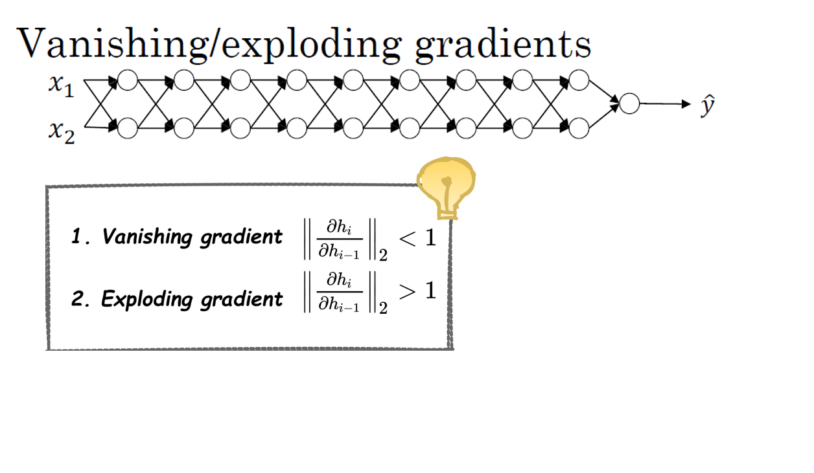

Slide 56
Vanishing/exploding gradients
One solution is to carefully initialize the weights to reduce the impact of vanishing or exploding gradients. This can help reduce the problem, but it does not completely solve it.

Slide 57
Setting up your optimization problem
Weight Initialization for Deep Networks

Slide 58
Weight Initialization for Deep Networks
Zeros initialization: initializing all weights and biases to zero in neural networks, is a simple but discouraged technique. It causes symmetry issues during training, as all neurons in a layer learn the same features, making them redundant and hindering effective learning.
Random initialization is a common neural network weight initialization method. It breaks symmetry by assigning random values from a chosen distribution to weights and biases. Techniques include Uniform Initialization and Normal (Gaussian) Initialization, chosen based on the activation function.
Notes:
Zeros initialization is a weight initialization technique used in neural networks and other machine learning models. In this technique, all the weights and biases of the model are initialized to zero at the beginning of training. It is one of the simplest initialization methods, but it has some significant drawbacks and is generally not recommended for deep neural networks.The main issue with initializing all weights to zero is that it leads to symmetry in the activations during forward and backward propagation. Since all weights have the same value, each neuron's output is identical, and they all update in the same way during backpropagation. As a result, each neuron in a given layer will learn the same features, making the neurons redundant and causing them to behave as if they were a single neuron.
Random initialization is a commonly used weight initialization technique in neural networks. In this method, the weights and biases of the neural network are initialized with random values from a chosen probability distribution. Random initialization helps to break the symmetry among neurons and allows the model to learn diverse and meaningful representations during training.There are different strategies for random weight initialization, and the choice of distribution depends on the activation function being used in the neural network. Two widely used random initialization techniques are:
- Uniform Initialization
- Normal (Gaussian) Initialization

Slide 59
Weight Initialization for Deep Networks
ReLU and variants use weight initialization to set the variance proportionate to 1/n, controlling activation and gradient ranges.
Xavier/Glorot (for linear-like functions) sets variance to 1/n(l-1), where n(l-1) is the number of units feeding into each unit in layer l.
He initialization (for rectified functions) sets variance to 2/n(l-1), where n(l-1) is the number of units feeding into each unit in layer l.
Notes:
For the case of ReLU and its variants, the weight initialization are indeed based on the idea of setting the variance of the weight matrix proportional to 1/n. The goal is to control the range of the activations and gradients during training, which helps to prevent vanishing and exploding gradients.
For activation functions with linear-like characteristics (e.g., sigmoid, tanh), Xavier/Glorot initialization sets the variance of the weight matrix to 1/n(l-1), where n(l-1) is the number of units feeding into each unit in layer l.
For activation functions with a rectified nature (e.g., ReLU, Leaky ReLU), He initialization sets the variance of the weight matrix to 2/n(l-1), where n(l-1) is the number of units feeding into each unit in layer l.

Slide 60
Weight Initialization for Deep Networks
He initialization" or "He et al. initialization." It is commonly used for weight initialization in deep neural networks, especially when the activation function is a rectified linear unit (ReLU) or its variants.
The He initialization formula for the weight matrix of layer l is given as follows:
W^{[l]} = np.random.randn * sqrt(2/n(l-1))
Where:
W^{[l]}: The weight matrix of layer l.
np.random.randn: A random number drawn from a standard normal distribution.
sqrt(2/n(l-1)): The scaling factor for the weight initialization.
Notes:
He initialization" or "He et al. initialization." It is commonly used for weight initialization in deep neural networks, especially when the activation function is a rectified linear unit (ReLU) or its variants. The initialization helps address the vanishing and exploding gradients problem, which can occur during the training of deep neural networks.
The He initialization formula for the weight matrix of layer l is given as follows:
W(l) = np.random.randn * sqrt(2/n(l-1)),
Where:
W(l): The weight matrix of layer l.
np.random.randn: A random number drawn from a standard normal distribution.
sqrt(2/n(l-1)): The scaling factor for the weight initialization.

Slide 61
Weight Initialization for Deep Networks
Weight initialization varies for activation functions:
- TanH uses Xavier initialization, setting variance to 1/n instead of 2/n.
- Another version (Yoshua Bengio and colleagues) uses an alternative formula.
These formulas provide starting points for weight variance, fine-tuned with hyperparameters.
Careful initialization aids faster training and mitigates vanishing/exploding gradient issues.
Notes:
Other variants of weight initialization for different activation functions:
- The TanH activation function. The Xavier initialization is used for TanH activation function, and it involves setting the variance to be 1/n instead of 2/n.
- Another version, taught by Yoshua Bengio and colleagues, uses a different formula that has some theoretical justification.
In practice, all these formulas give a starting point for the variance of the weight initialization, which can be tuned with hyperparameters. Tuning this parameter can help reduce the vanishing and exploding gradients problem, but it is usually lower down in importance relative to other hyperparameters.
Overall, careful choice of weight initialization can help make neural networks train much more quickly, and avoid the problem of vanishing or exploding gradients.

Slide 62
Setting up your optimization problem
Numerical approximation of gradients

Slide 63
Numerical approximation of gradients
Numerical approximation of gradients is a technique used to estimate the gradients of a function with respect to its parameters by computing finite differences. It is commonly used in gradient checking, as described in the Gradient checking, to verify the correctness of analytical gradients computed through methods like backpropagation.
Notes:
Backpropagation is a commonly used algorithm in neural networks to calculate the gradient of the loss function with respect to the network parameters. It is used to train the network by adjusting the weights and biases to minimize the loss. However, implementing backpropagation can be complex and there may be errors in the implementation. To ensure that the implementation is correct, gradient checking can be used.
Gradient checking is a numerical method used to verify whether the gradient of a function is calculated correctly. It works by approximating the derivative using a two-sided difference formula. Instead of just nudging the parameter to the right to get theta plus epsilon, the parameter is nudged to the right and left to get theta minus epsilon and theta plus epsilon, respectively. Then, the height over the width of a larger triangle is computed to get a better estimate of the derivative.

Slide 64
Numerical approximation of gradients
Given a function f(θ) that depends on a set of parameters θ, the numerical approximation of the gradient of f with respect to each parameter θi can be calculated using the following formula:
Numerical gradient for θi = (f(θ + ε * ei) - f(θ - ε * ei)) / (2 * ε),
Where:
f(θ + ε * ei): The function evaluated at θ with a small perturbation ε added to the ith parameter (θi + ε).
f(θ - ε * ei): The function evaluated at θ with a small perturbation ε subtracted from the ith parameter (θi - ε).
ε (epsilon): A small value used to perturb the parameter slightly.
ei: A unit vector in the direction of the ith parameter (all zeros except at position i).

Slide 65
Numerical approximation of gradients
The numerical gradient is obtained by calculating the difference between the function evaluations at the perturbed parameter values, divided by 2ε. This finite difference approximation provides an estimate of how the function changes concerning changes in the ith parameter.
When performing numerical gradient approximation, it is crucial to choose an appropriate value for ε. A value that is too large might lead to inaccurate approximations, while a value that is too small may introduce numerical instability due to finite precision errors. Common choices for ε are in the range of 1e-4 to 1e-8, depending on the scale and nature of the problem.

Slide 66
Numerical approximation of gradients
Numerical approximation of gradients is a useful tool for verifying the correctness of gradient calculations in complex functions and models.
However, it can be computationally expensive, especially for high-dimensional models, so it is typically used for debugging and validation purposes rather than in regular training iterations.
Once the correctness of gradient computations is confirmed, analytical gradients (e.g., obtained through backpropagation) are generally used for efficient parameter updates during the training process.

Slide 67
Setting up your optimization problem
Gradient Checking

Slide 68
Gradient check for a neuron network
Gradient checking is a technique used to verify the correctness of the implementation of backpropagation in neural networks.
Gradient checking steps:
Flatten all parameters into a vector "theta."
Define cost function J(theta).
Compute numerical gradients using finite differences.
Use backpropagation to compute analytical gradients.
Compare numerical and analytical gradients.
Calculate the difference using a suitable metric.
Check if the difference is below a predefined threshold to validate the backpropagation implementation.
Gradient checking validates and corrects errors in gradient computation, ensuring accurate learning and improved model performance during training with optimization algorithms like gradient descent.
Notes:
The steps involved in gradient checking:
Reshape Parameters: All the parameters of the neural network, such as weights (W1, W2, etc.) and biases (B1, B2, etc.), are flattened and combined into a single parameter vector called "theta."
Define Cost Function: Express the cost function J, which represents the loss function of the neural network, as a function of the parameter vector theta.
Numerical Gradient Approximation: Compute the numerical approximation of the gradient for each component of the parameter vector theta using the two-sided difference formula (finite difference approximation).
Analytical Gradient Computation: Use backpropagation to compute the analytical gradient of the cost function with respect to each component of theta.
Compare Gradients: Compare the numerical gradients (d theta approx) with the analytical gradients (d theta) for each component of theta.
Compute Difference: Calculate the difference between the numerical and analytical gradients using the Euclidean distance or some other appropriate distance metric.
Check Difference: If the difference between the numerical and analytical gradients is very small (below a predefined threshold), it indicates that the implementation of backpropagation is likely correct. Otherwise, there might be a bug in the gradient computation that needs to be addressed.
By performing gradient checking, you can gain confidence in the correctness of your backpropagation implementation, especially in complex neural network architectures. It helps to identify and fix errors, ensuring that the model learns the correct gradients and leads to better training and improved performance on the target task. After validating the gradient computation, you can proceed with training the neural network using optimization algorithms like gradient descent or its variants.

Slide 69
Implement Gradient check
Setting epsilon to 10⁻⁷ in gradient checking ensures the correctness of the derivative approximation. Values much smaller than 10⁻⁷ indicate accuracy, while those in the range of 10⁻⁵ may need careful inspection. If values are significantly larger than 10⁻³, potential bugs may exist.
Gradient checking is a valuable tool for bug detection and boosting confidence in backpropagation implementations.
Notes:
To implement gradient checking, epsilon is typically set to 10⁻⁷. If the formula gives a value much smaller than 10⁻⁷, it means that the derivative approximation is correct. If the value is in the range of 10⁻⁵, then it may be okay, but the components of the vector should be carefully checked. If the value is much larger than 10⁻³, then there may be a bug somewhere.
Gradient checking has helped many people find bugs in their implementations of backpropagation. It can save a lot of time and improve the confidence in the implementation's correctness.

Slide 70
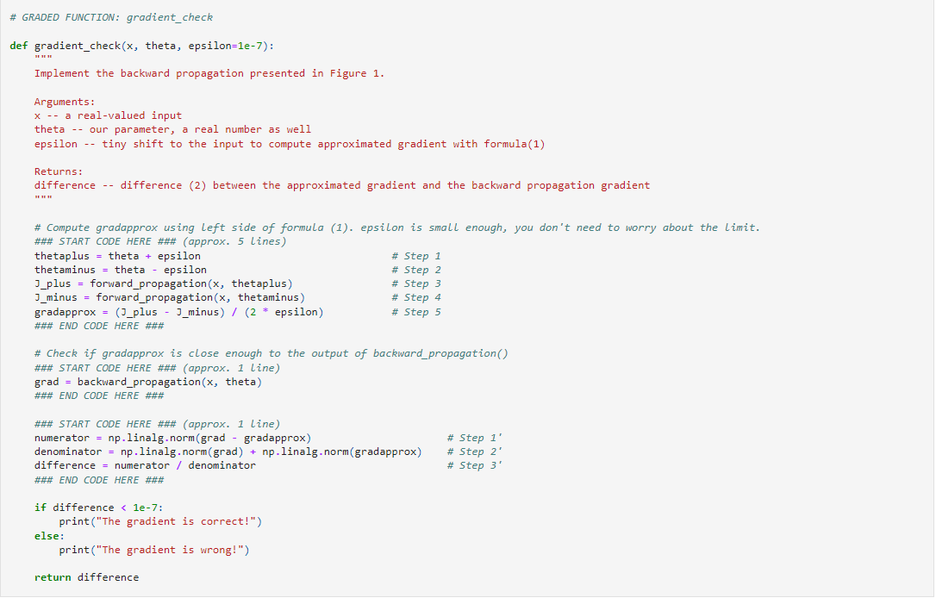
Gradient checking

Slide 71
Setting up your optimization problem
Gradient Checking implementation notes

Slide 72
Gradient checking implementation notes
Don’t use in training – only to debug
If algorithm fails grad check, look at components to try to identify bug.
Remember regularization.
Doesn’t work with dropout.
Run at random initialization; perhaps again after some training.

Slide 73
Summarization
Datasets are split into train (for training), dev (for tuning), and test (for evaluation).
Bias is underfitting error, and variance is sensitivity to data fluctuations, causing overfitting.
The machine learning "recipe" involves data gathering, splitting, model selection, initialization, training, validation, and testing.
Regularization prevents overfitting by adding penalty terms to the cost function, discouraging complexity. It reduces overfitting by penalizing complexity, leading to more generalizable models.
Dropout regularization randomly drops neurons during training to further reduce overfitting.
Normalizing inputs involves scaling them to zero mean and unit variance for improved optimization convergence.
Vanishing/exploding gradients in deep networks occur when gradients become too small or large during backpropagation.
Notes:
Train/Dev/Test Sets: Datasets are split into three sets - train (for training the model), dev (for hyperparameter tuning), and test (for final evaluation).
Bias/Variance: Bias refers to the error from underfitting, and variance refers to sensitivity to data fluctuations, leading to overfitting.
Basic "Recipe" for Machine Learning: Steps for building and evaluating machine learning models, including data gathering, splitting, model selection, initialization, training, validation, and testing.
Regularization: Technique to prevent overfitting by adding penalty terms to the cost function, discouraging complex models.
Why Regularization Reduces Overfitting: Regularization penalizes complexity, leading to more generalizable models.
Dropout Regularization: Randomly drops neurons during training to reduce overfitting.
Understanding Dropout: Dropout improves generalization by avoiding over-reliance on specific neurons.
Other Regularization Methods: L1, L2 regularization, elastic net, and early stopping are alternative regularization techniques.
Normalizing Inputs: Scaling input features to have zero mean and unit variance can enhance convergence in optimization algorithms.
Vanishing/Exploding Gradients: Issues with gradients becoming too small or large during backpropagation in deep networks.
Numerical Approximation of Gradients: Technique to verify the correctness of analytical gradients using finite differences.
Gradient Checking: Process of comparing analytical and numerical gradients to ensure accurate gradient computations.
Gradient Checking Implementation Notes: Implementation steps for gradient checking.

Slide 74
Summarization
Numerical approximation of gradients using finite differences helps verify the correctness of analytical gradients.
Gradient checking involves comparing analytical and numerical gradients to ensure accuracy.
Notes:
Train/Dev/Test Sets: Datasets are split into three sets - train (for training the model), dev (for hyperparameter tuning), and test (for final evaluation).
Bias/Variance: Bias refers to the error from underfitting, and variance refers to sensitivity to data fluctuations, leading to overfitting.
Basic "Recipe" for Machine Learning: Steps for building and evaluating machine learning models, including data gathering, splitting, model selection, initialization, training, validation, and testing.
Regularization: Technique to prevent overfitting by adding penalty terms to the cost function, discouraging complex models.
Why Regularization Reduces Overfitting: Regularization penalizes complexity, leading to more generalizable models.
Dropout Regularization: Randomly drops neurons during training to reduce overfitting.
Understanding Dropout: Dropout improves generalization by avoiding over-reliance on specific neurons.
Other Regularization Methods: L1, L2 regularization, elastic net, and early stopping are alternative regularization techniques.
Normalizing Inputs: Scaling input features to have zero mean and unit variance can enhance convergence in optimization algorithms.
Vanishing/Exploding Gradients: Issues with gradients becoming too small or large during backpropagation in deep networks.
Numerical Approximation of Gradients: Technique to verify the correctness of analytical gradients using finite differences.
Gradient Checking: Process of comparing analytical and numerical gradients to ensure accurate gradient computations.
Gradient Checking Implementation Notes: Implementation steps for gradient checking.

